Slide 1

Bayesian Statistics

Slide 2
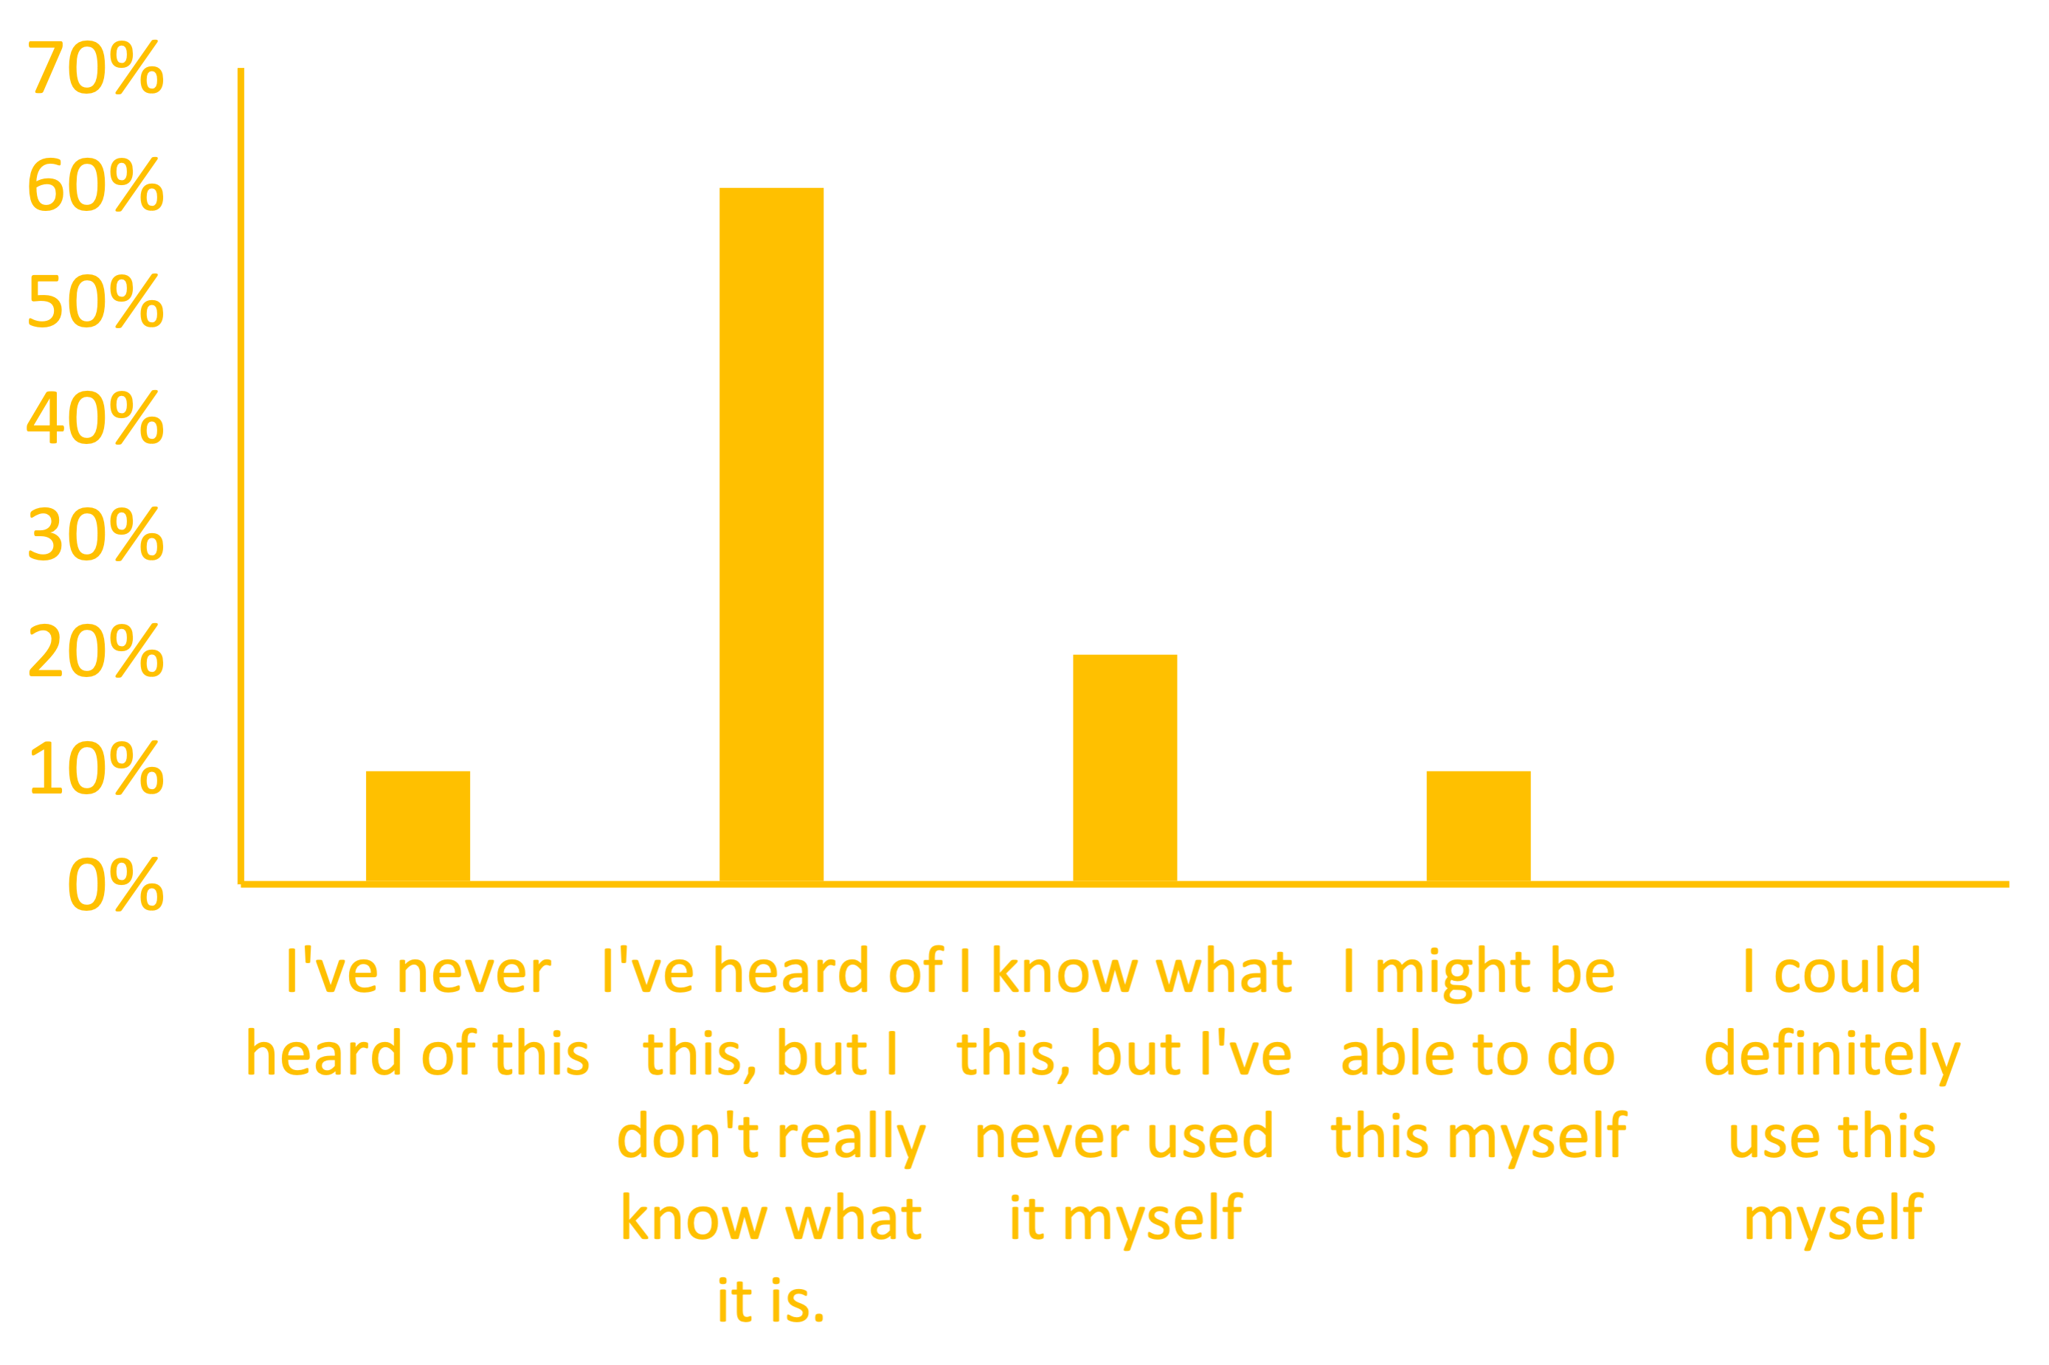

Slide 3
Overview of Bayesian Stats
Why bother?
Principles of Probability
The Bayes Factor
Setting Appropriate Priors
BRMs & Stan – The R Code
Reporting Your Results

Slide 4

Why Bother?
The classic example:
Do you believe in ESP?

Slide 5
Why Bother?
The classic example:
Do you believe in ESP?
Real Slate Headline:
Daryl Bem Proved ESP Is Real
Which means science is broken.

Slide 6
Why Bother?
The classic example:
Do you believe in ESP?
You
0
ESP is real as Alternative Hypothesis

Slide 7
Why Bother?
The classic example:
1 article
You
0
ESP is real based on 1 experiment

Slide 8
Why Bother?
The classic example:
100 article
You
0
ESP is real based on meta-analysis

Slide 9
Why Bother?
The classic example:
Neil deGrasse Tyson
You
0
ESP is real based on review of meta-analysis as statistically solid

Slide 10
Why Bother?
The classic example:
Neil deGrasse Tyson
Prior Belief
Posterior Belief
0
ESP is real based on review of meta-analysis as statistically solid

Slide 11
Why Bother?
Prior Belief
Likelihood
0

Slide 12
Why Bother?
Prior Belief
Posterior Belief
Likelihood
0

Slide 13
Why Bother?
Allows us to account for a wealth of prior literature
Allows for proving the null
What is a p-value?
The probability of obtaining test results at least as extreme as the results actually observed, under the assumption that the null hypothesis correct.
Notes:
One rogue finding doesn’t change our beliefs. We’re doing it anyway; bayes rule lets us do it statistically.

Slide 14
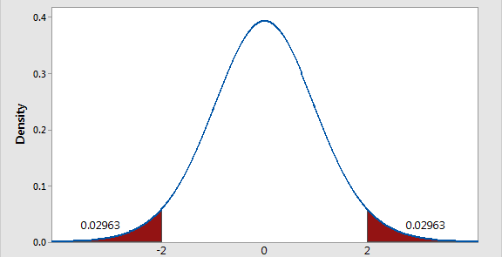
Why Bother?
p-values
Notes:
The normal distribution here represents the distribution of responses we’d expect if the null hypothesis was true. We get a data point in here. This is unlikely to occur in the normal distribution. It’s more likely to occur in some other distribution, perhaps the one in which ESP is real.
But how much more likely?
reject the null, but that doesn’t mean the null is true. It just means that if the null is true, we’d be unlikely to see this value.
And if we get a value here, we’ve failed to reject the null but that doesn't mean the null is true

Slide 15

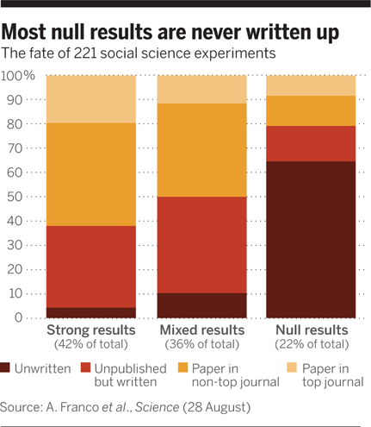

Why Bother?
p-values
Notes:
At some point, you’re going to get null results, and you’re going to wonder, well does this mean the theory is wrong? If it is wrong, that would be worth writing about. Then I don’t have to throw away all my work.

Slide 16
Why Bother?
p-values
Notes:
At some point, you’re going to get null results, and you’re going to wonder, well does this mean the theory is wrong? If it is wrong, that would be worth writing about. Then I don’t have to throw away all my work and data.

Slide 17
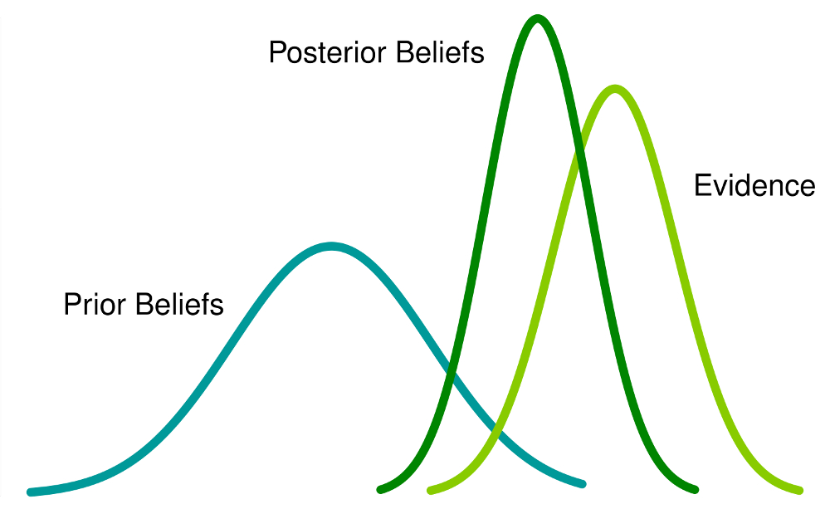
Why Bother?
Proving the null
Given the null hypothesis, how likely is my data
Given the data, which hypothesis is more likely (the null or the alternative)
y = b0
y = b0 + b1
Notes:
In some ways, Bayesian statistics just changes the questions. Instead of asking, how likely is the data given the null hypothesis, we ask, given the data which hypothesis is most likely, the null or the alternative.

Slide 18
Why Bother?
Allows us to account for a wealth of prior literature
Allows for proving the null
What is a p-value?
The probability of obtaining test results at least as extreme as the results actually observed, under the assumption that the null hypothesis correct.
More reliable results with less data
Notes:
Another benefit is that we can use our priors as a substitute for not having much data.

Slide 19
Why Bother?
Few Observations
# of Coin Tosses | # of heads | % of heads | Heads/Tails are not equal
2 | 0 | 0% | undetermined
10 | 2 | 20% | p = .05
20 | 13 | 65% | p = .19
100 | 46 | 46% | p = .43
Notes:
The null hypothesis is that heads/tails are equal. How likely is it I find my pattern of data given the null hypothesis? With only 10 tosses, I get a marginal result.

Slide 20
Why Bother?
Few Observations
# of Coin Tosses | # of heads | % of heads | Heads/Tails are not equal
2 | 0 | 0% | undetermined
10 | 2 | 20% | p = .05
20 | 13 | 65% | p = .19
100 | 46 | 46% | p = .43
# of Coin Tosses | # of heads | % of heads
1002 | 500 | 49.9%
1010 | 502 | 49.7%
1020 | 513 | 50.29%
1100 | 546 | 49.64%
Notes:
But we have very strong prior ideas that this split is 50/50. So what bayes let’s us do is essentially add those beliefs.
It’s sort of like we’re adding 1000 tosses which perfectly reflect he null.

Slide 21
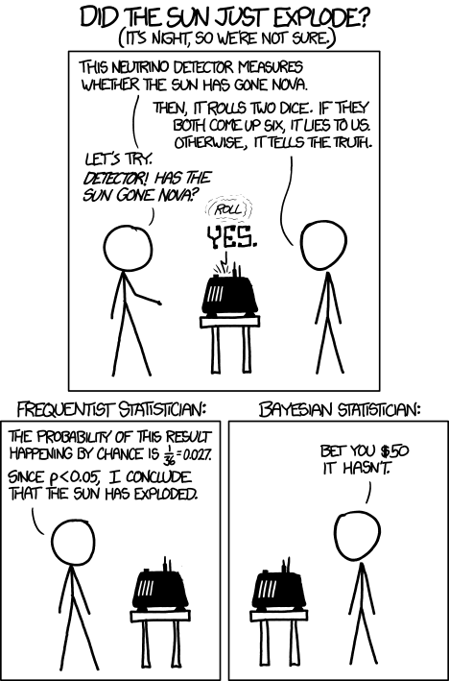
Why Bother?

Slide 22
Overview of Bayesian Stats
Principles of Probability
The Bayes Factor
Setting Appropriate Priors
BRMs & Stan – The R Code
Reporting Your Results
Why bother?
Notes:
where bayes theorum comes from

Slide 23
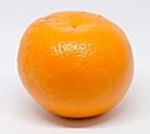
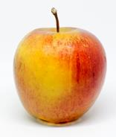
Principles of Probability
What is the probability of randomly selecting an orange?
Credit Joseph Yurko, Machine Learning, Information Sciences 2595

Slide 24
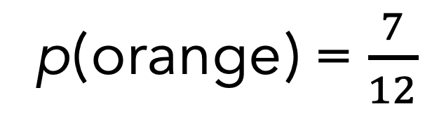
Principles of Probability
What is the probability of randomly selecting an orange?
7
12
p(orange) = $\frac{7}{12}$
Credit Joseph Yurko, Machine Learning, Information Sciences 2595
Notes:
7 oranges out of 12 fruits

Slide 25


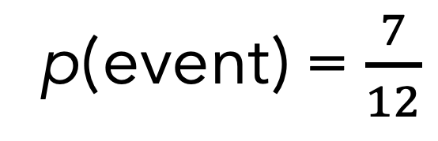
Principles of Probability
What is the probability of randomly getting an event?
7
12
p(event) = $\frac{7}{12}$
Credit Joseph Yurko, Machine Learning, Information Sciences 2595
Notes:
Can also think of this as the probability of an event out of the number of trials.

Slide 26
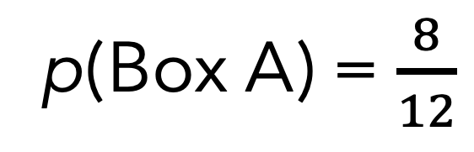
Principles of Probability
p(Box A) = $\frac{8}{12}$
What is the probability of that fruit you randomly selected came from Box A?
Box A
Box B
Credit Joseph Yurko, Machine Learning, Information Sciences 2595
Notes:
Stick with fruit because it’s less abstract

Slide 27
Principles of Probability
p(Box A) = $\frac{8}{12}$
What is the probability of that fruit you randomly selected came from Box A?
Box A
Marginal Probability
Box B
Credit Joseph Yurko, Machine Learning, Information Sciences 2595
Notes:
This is also called the marginal probability

Slide 28
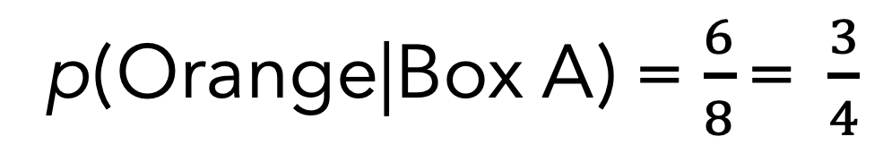
Principles of Probability
p(Orange|Box A) = $\frac{6}{8}\text{= }\frac{3}{4}$
What is the probability of randomly selecting an orange given Box A?
Box A
Box B
Credit Joseph Yurko, Machine Learning, Information Sciences 2595
Notes:
Conditional Probability

Slide 29
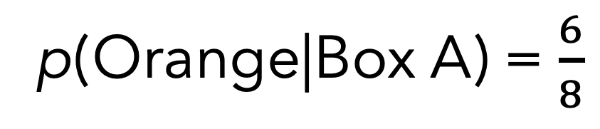
Principles of Probability
p(Orange|Box A) = $\frac{6}{8}$
What is the probability of randomly selecting an orange given Box A?
Box A
Conditional Probability
Credit Joseph Yurko, Machine Learning, Information Sciences 2595

Slide 30
Principles of Probability
What is the conditional probability of each combination?
Apple | 2/8 | 3/4
Orange | 6/8 | 1/4
 | A | B
Fruit
Box
Notes:
This the number for each combination (2 apples in box a and so on).
These are the conditional probabilities, but if box A isn't given, we had to consider also the probability of selecting box A.
When we add this in, it's called the joint probability, so we’ll rewrite the question

Slide 31
Principles of Probability
What is the joint probability of each combination?
Apple | p(Apple & Box A) 2/ | p(Apple & Box B) 3/
Orange | p(Orange & Box A) 6/ | p(Orange & Box B) 1/
 | A | B
Fruit
Box

Slide 32
Principles of Probability
What is the joint probability of each combination?
Apple | p(Apple & Box A) 2/12 | p(Apple & Box B) 3/12
Orange | p(Orange & Box A) 6/12 | p(Orange & Box B) 1/12
 | A | B
Fruit
Box
Notes:
To get that, we divide by the number of fruit or you could think of this as the number of observations or trials.

Slide 33
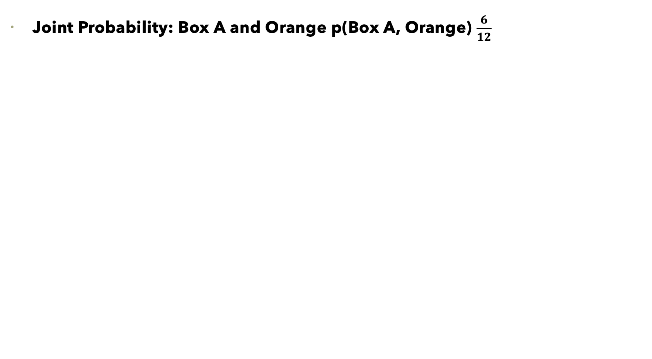
Principles of Probability
Joint Probability: Box A and Orange p(Box A, Orange) $\frac{6}{12}$
Box A
Box B
Credit Joseph Yurko, Machine Learning, Information Sciences 2595
Notes:
We can write the joint probability with a comma instead of an and sign

Slide 34
Principles of Probability
Marginal Probability: p(orange)
Conditional Probability: p(Orange | Box A)
Joint Probability: p(Orange , Box A)
Sum Rule
p(Orange) = p(Orange, Box A) + p(Orange, Box B)
Notes:
To get into Bayes, we need to understand the sum and product rules of probability.
the marginal probability is = to the sum of the joint probabilities

Slide 35
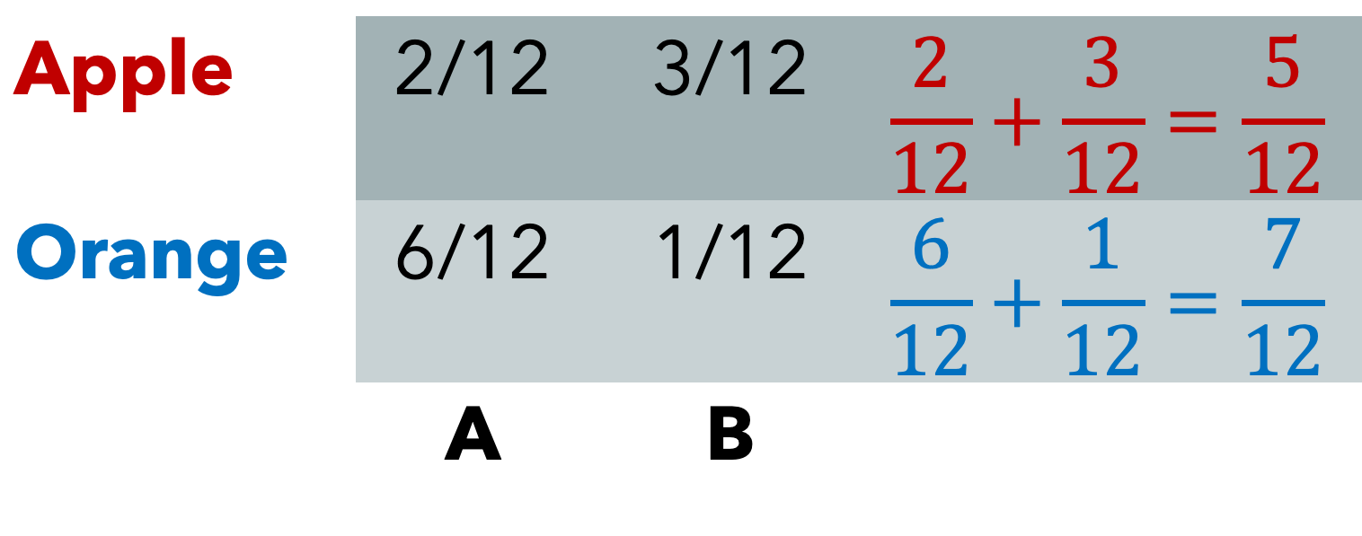
Principles of Probability
Sum Rule of Probability: p(Orange , Box A) + p(Orange , Box B) = p(Orange)
Apple | 2/12 | 3/12 | $$\frac{2}{12}+\frac{3}{12}=\frac{5}{12}$$
Orange | 6/12 | 1/12 | $$\frac{6}{12}+\frac{1}{12}=\frac{7}{12}$$
 | A | B
Fruit
Box
Notes:
This is the sum rule of probability. The marginal probability is the sum of the joint probabilities

Slide 36
Principles of Probability
Marginal Probability: p(orange)
Conditional Probability: p(Orange | Box A)
Joint Probability: p(Orange , Box A)
Sum Rule
p(Orange) =p(Orange, Box A) + p(Orange, Box B)
Product Rule
p(Orange , Box A) = p(Orange | Box A) x p(Box A)
p(Orange , Box B) = p(Orange | Box B) x p(Box B)
Notes:
Joint probability = Conditional probability x the marginal probability

Slide 37
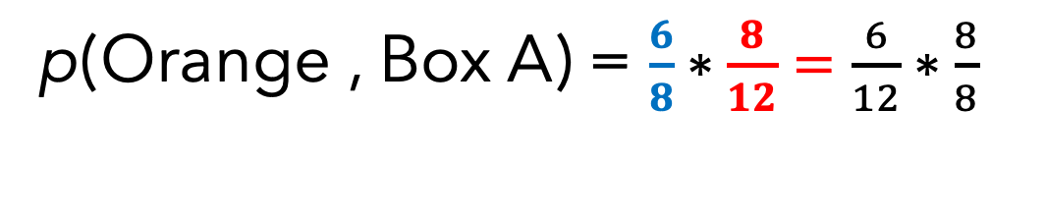
Principles of Probability
Conditional Probability
Marginal Probability
Box A
p(Orange , Box A) = $\frac{6}{8}∗\frac{8}{12}=\frac{6}{12}∗\frac{8}{8}$
Notes:
Marginal probability is the probability of pick Box A

Slide 38
Principles of Probability
Sum Rule
p(Orange) =p(Orange, Box A) + p(Orange , Box B)
Product Rule
p(Orange , Box A) = p(Orange | Box A) x p(Box A)
p(Orange , Box B) = p(Orange | Box B) x p(Box B)
Combined
p(Orange) = p(Orange | Box A) x p(Box A) + p(Orange | Box B) x p(Box B)
Credit Joseph Yurko, Machine Learning, Information Sciences 2595

Slide 39
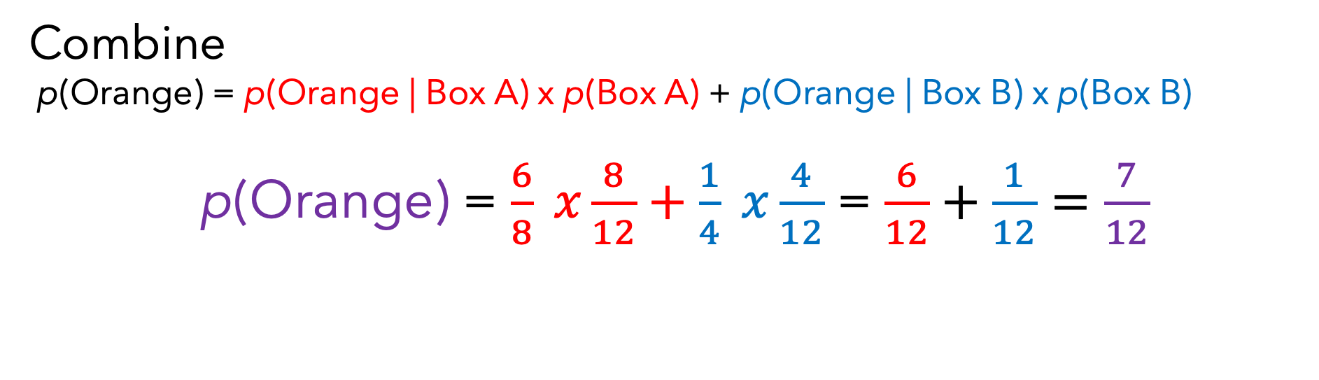
Principles of Probability
Combine
p(Orange) = p(Orange | Box A) x p(Box A) + p(Orange | Box B) x p(Box B)
p(Orange) = $\frac{6}{8} x\frac{8}{12}+\frac{1}{4} x\frac{4}{12}$ = $\frac{6}{12}+\frac{1}{12}=\frac{7}{12}$
Credit Joseph Yurko, Machine Learning, Information Sciences 2595

Slide 40
Principles of Probability
Joint Probabilities
p(Box A, Orange) = p(Orange | Box A) x p(Box A)
p(Orange, Box A) = p(Box A | Orange) x p(Orange)
p(Orange, Box A) = p(Box A, Orange)
p(Orange | Box A) x p(Box A) = p(Box A | Orange) x p(Orange)
Credit Joseph Yurko, Machine Learning, Information Sciences 2595
Notes:
What about when we don’t know the counts? We can start to rearrange and find that the if we just know either box A or Orange, we can figure out this result
animate this slide

Slide 41
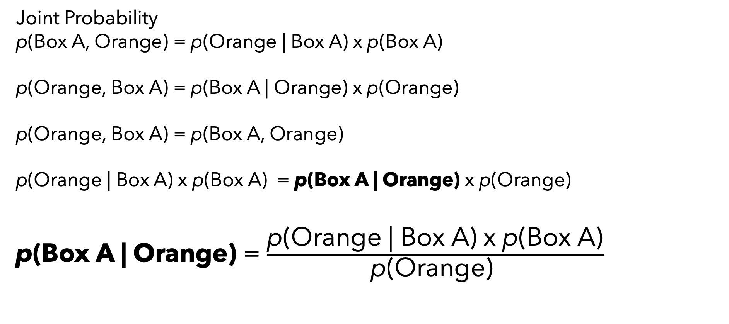
Principles of Probability
Joint Probability
p(Box A, Orange) = p(Orange | Box A) x p(Box A)
p(Orange, Box A) = p(Box A | Orange) x p(Orange)
p(Orange, Box A) = p(Box A, Orange)
p(Orange | Box A) x p(Box A) = p(Box A | Orange) x p(Orange)
p(Box A | Orange) = $\frac{\text{p}\text{(}\text{Orange}\text{ | }\text{Box} \text{A}\text{) }\text{x} \text{p}\text{(}\text{Box} \text{A}\text{)}}{\text{p}\text{(}\text{Orange}\text{) }}$
Credit Joseph Yurko, Machine Learning, Information Sciences 2595
Notes:
So now if I want to know the probability of box given that I selected an orange, all I have to do is divide by the probability of an orange.

Slide 42
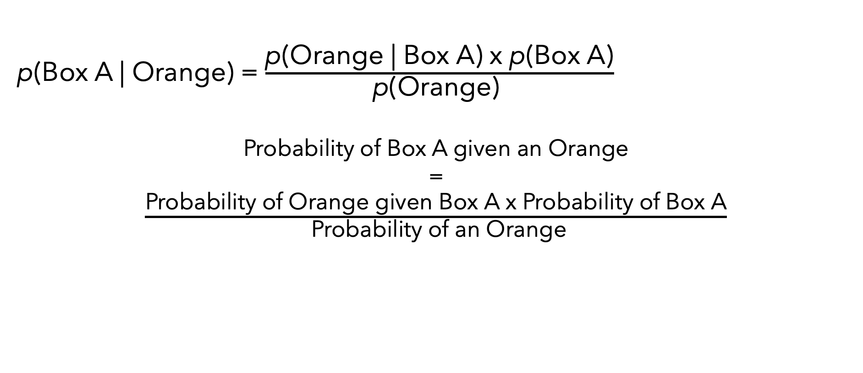
Principles of Probability
Bayes’ Theorem
p(Box A | Orange) = $\frac{\text{p}\text{(}\text{Orange}\text{ | }\text{Box} \text{A}\text{) }\text{x} \text{p}\text{(}\text{Box} \text{A}\text{)}}{\text{p}\text{(}\text{Orange}\text{) }}$
Probability of Box A given an Orange
=
$\frac{\text{Probability} \text{of} \text{Orange} \text{given} \text{Box} \text{A} \text{x} \text{Probability} \text{of} \text{Box} \text{A}}{ \text{Probability} \text{of} \text{an} \text{Orange}}$
Credit Joseph Yurko, Machine Learning, Information Sciences 2595

Slide 43
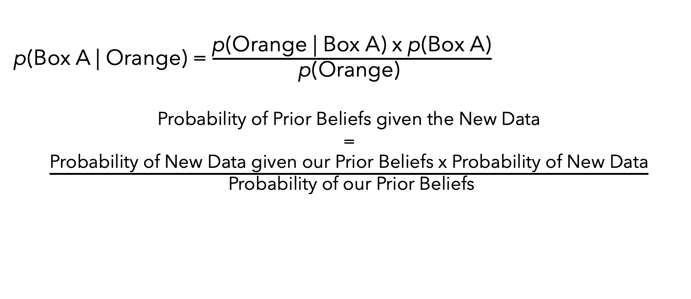
Principles of Probability
Bayes’ Theorem
p(Box A | Orange) = $\frac{\text{p}\text{(}\text{Orange}\text{ | }\text{Box} \text{A}\text{) }\text{x} \text{p}\text{(}\text{Box} \text{A}\text{)}}{\text{p}\text{(}\text{Orange}\text{) }}$
Probability of Prior Beliefs given the New Data
=
$\frac{\text{Probability} \text{of} \text{New} \text{Data} \text{given} \text{our} \text{Prior} \text{Beliefs} \text{x} \text{Probability} \text{of} \text{New} \text{Data}}{ \text{Probability} \text{of} \text{our} \text{Prior} \text{Beliefs}}$
Credit Joseph Yurko, Machine Learning, Information Sciences 2595

Slide 44
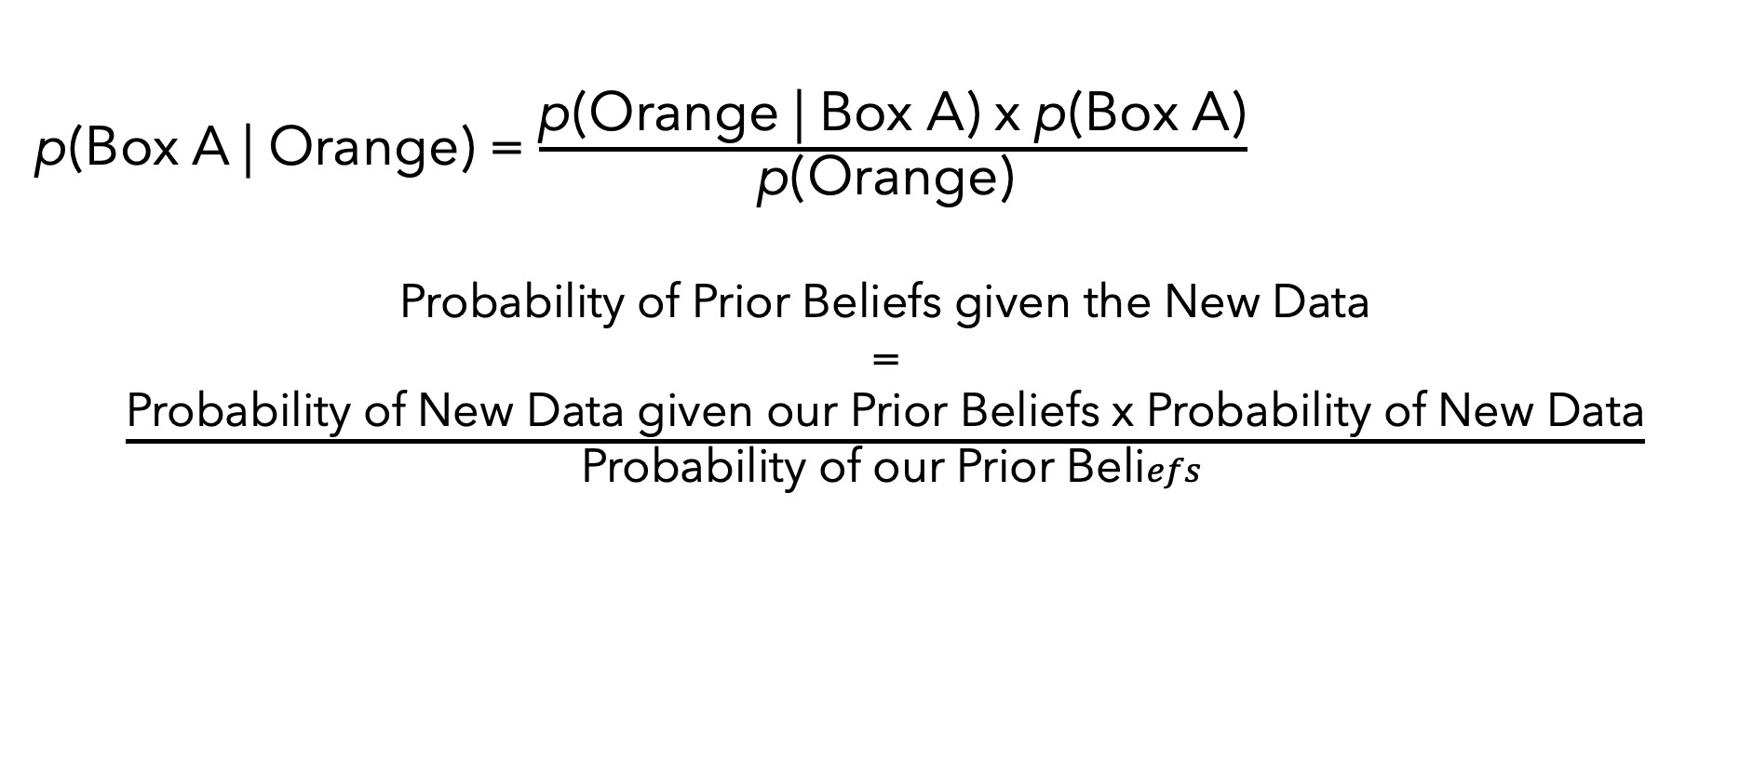
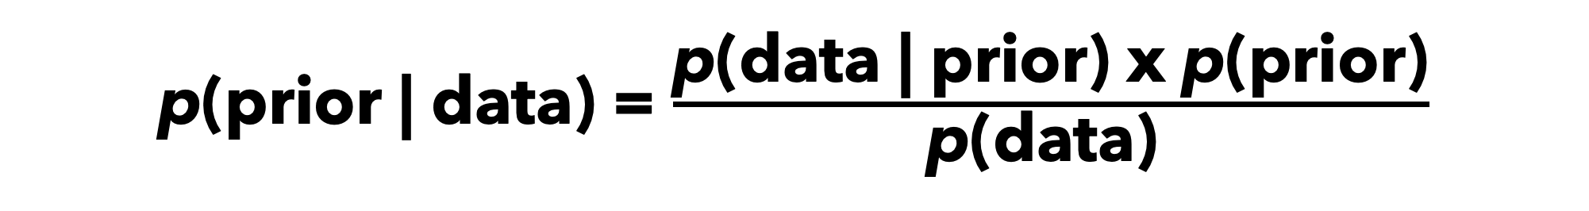
Principles of Probability
Bayes’ Theorem
p(Box A | Orange) = $\frac{\text{p}\text{(}\text{Orange}\text{ | }\text{Box} \text{A}\text{) }\text{x} \text{p}\text{(}\text{Box} \text{A}\text{)}}{\text{p}\text{(}\text{Orange}\text{) }}$
Probability of Prior Beliefs given the New Data
=
$\frac{\text{Probability} \text{of} \text{New} \text{Data} \text{given} \text{our} \text{Prior} \text{Beliefs} \text{x} \text{Probability} \text{of} \text{New} \text{Data}}{ \text{Probability} \text{of} \text{our} \text{Prior} \text{Beli}efs}$
p(prior | data) = $\frac{\text{p}\text{(}\text{data}\text{ | }\text{prior}\text{) }\text{x} \text{p}\text{(}\text{prior}\text{)}}{\text{p}\text{(}\text{data}\text{) }}$
Credit Joseph Yurko, Machine Learning, Information Sciences 2595

Slide 45
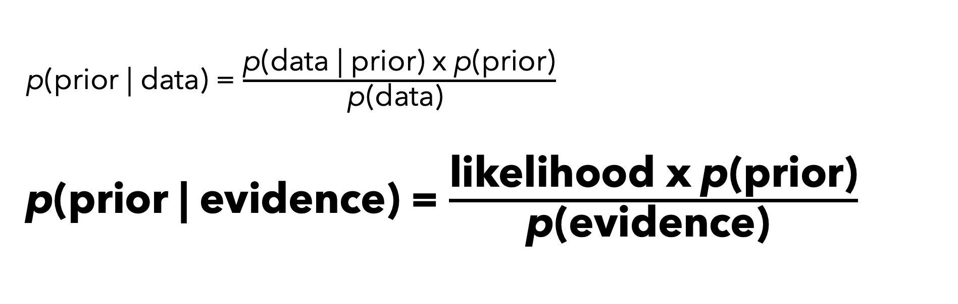
Principles of Probability
Bayes’ Theorem
p(prior | data) = $\frac{\text{p}\text{(}\text{data}\text{ | }\text{prior}\text{) }\text{x} \text{p}\text{(}\text{prior}\text{)}}{\text{p}\text{(}\text{data}\text{) }}$
p(prior | evidence) = $\frac{\text{likelihood} \text{x} \text{p}\text{(}\text{prior}\text{)}}{\text{p}\text{(}\text{evidence}\text{) }}$
Credit Joseph Yurko, Machine Learning, Information Sciences 2595
Notes:
The probability of the orange given box a or the probability of the data given the prior can also be written as the likelihood. And the data is our evidence.

Slide 46

Principles of Probability
Bayes’ Theorem
p(prior | data) = $\frac{\text{p}\text{(}\text{data}\text{ | }\text{prior}\text{) }\text{x} \text{p}\text{(}\text{prior}\text{)}}{\text{p}\text{(}\text{data}\text{) }}$
p(prior | evidence) = $\frac{\text{likelihood} \text{x} \text{p}\text{(}\text{prior}\text{)}}{\text{p}\text{(}\text{evidence}\text{) }}$
Posterior ∝ $\text{likelihood} \text{x} \text{p}\text{(}\text{prior}\text{)}$
Credit Joseph Yurko, Machine Learning, Information Sciences 2595
Notes:
Functionally, we can drop the probability of the data because we have the data and while this could matter, we’re really more interested in comparing the probabilities rather than getting the exact probability.
Also, probability of the evidence is to normalize but we don’t need to do that for inference.

Slide 47
Overview of Bayesian Stats
Principles of Probability
The Bayes Factor
Setting Appropriate Priors
BRMs & Stan – The R Code
Reporting Your Results
Why bother?

Slide 48
Setting Appropriate Priors
Hyper informative: Certainty
Informative: Strong Beliefs
Weakly informative: Weak Beliefs
Diffuse: Really weak beliefs
Flat: No Beliefs (every possibility is equally probable)
Notes:
Terms to know

Slide 49
Setting Appropriate Priors
y = vocabulary knowledge (a summed total across a variety of measures)
x = age
H₁ = Vocabulary knowledge goes up as age goes up
H₀ = Vocabulary knowledge remains the same over the lifespan (unlikely)

Slide 50
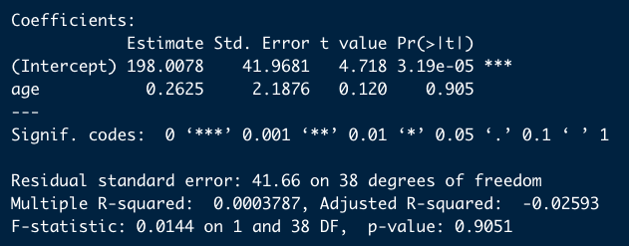
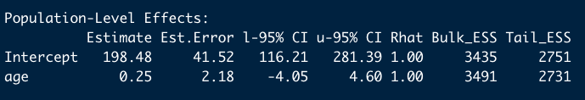
Setting Appropriate Priors
lm() output
brms() output with flat priors
Bayesian Regression Models using Stan (brms)
Notes:
Rhat is how good it is. Rhat should be 1 or you should increase the iterations.
CI is not a confidence interval, it’s a credible interval.
ESS – Effective sample size. Many iterations
Tail – beyond the 95% intervals
Bulk – within
Brms= Bayesian regression models using stan

Slide 51
Setting Appropriate Priors
diffuse <- c(set_prior("normal(5,100)", class = "b", coef = "age"))
weak <- set_prior("normal(5,10)", class = "b", coef = "age")
informative <- set_prior("normal(5,1)", class = "b", coef = "age")
Hyper informative <- set_prior("normal(5,0.1)", class = "b", coef = "age")

Slide 52
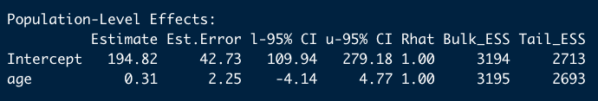
Setting Appropriate Priors
brms() output with flat priors
brms() output with diffuse priors
normal(5,100)
Notes:
point out the credible intervals

Slide 53
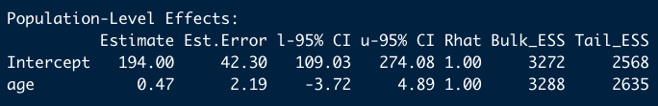
Setting Appropriate Priors
brms() output with diffuse priors
brms() output with weak priors
normal(5,10)
Notes:
Starting to pull towards 5

Slide 54
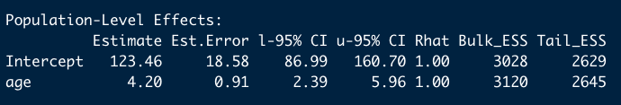
Setting Appropriate Priors
brms() output with weak priors
brms() output with informative priors
normal(5,1)
Notes:
point out credible intervals

Slide 55
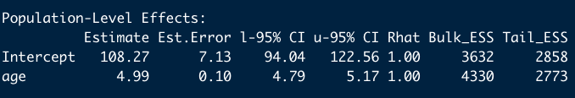
Setting Appropriate Priors
brms() output with informative priors
brms() output with hyper informative priors
normal(5, .1)
Notes:
Now it’s close to 5

Slide 56
Setting Appropriate Priors
Notes:
I write beta distribution, but I mean distribution of possible beta values. A beta distribution is something else.

Slide 57
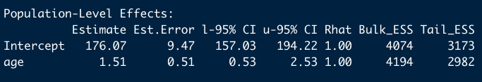
Setting Appropriate Priors
brms() output with informative priors – 40 observations
brms() output with informative priors – 400 observations
Notes:
animate this slide

Slide 58
Setting Appropriate Priors
40 obs
brms() output with informative priors – 40 observations
400 obs
brms() output with informative priors – 400 observations

Slide 59
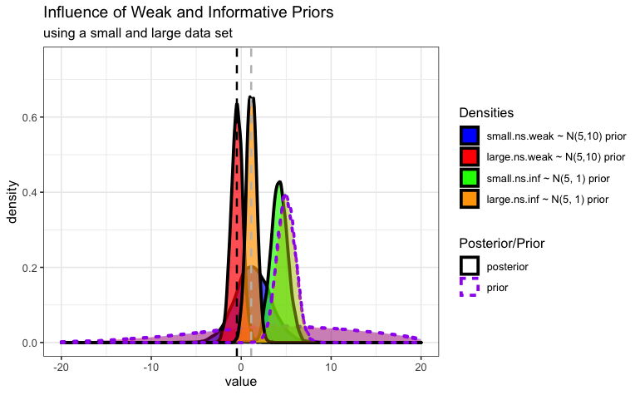
Notes:
An even easier way to understand this is to look at both the small and large data sets on the same graph.
Grey line is maximum likelihood for the small data
Black line is maximum likelihood for the large data set.
The bottom are the weak prior distributions in these cases, the posteriors fall right in line with the MLEs. Red and blue
But for the informative priors, the data shifts right. Only the small data shifts more than the large data set

Slide 60
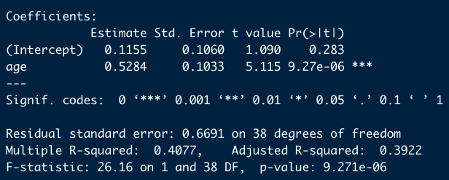
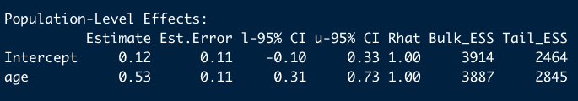
Setting Appropriate Priors
lm() output – sig data
brms() output with flat priors – sig data

Slide 61
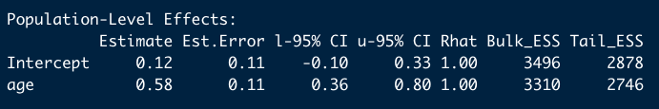
Setting Appropriate Priors
brms() output with flat priors – sig data
brms() output with informative priors – sig data

Slide 62
Setting Appropriate Priors
brms() output with informative priors – non sig data
brms() output with informative priors – sig data
Notes:
Less error in the data

Slide 63
Setting Appropriate Priors
Sig Data
n.s. Data

Slide 64
Setting Appropriate Priors
Sig Data
Sig Data

Slide 65
Overview of Bayesian Stats
Principles of Probability
The Bayes Factor
Setting Appropriate Priors
BRMs & Stan – The R Code
Reporting Your Results
Why bother?
Notes:
How do we use this data to make an inference? First Confidence intervals should not include 0.
But you may have heard of the bayes factor. It’s used a lot to supplement or replace p-values

Slide 66

The Bayes Factor
Controversy Warning

Slide 67
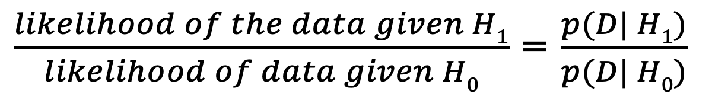
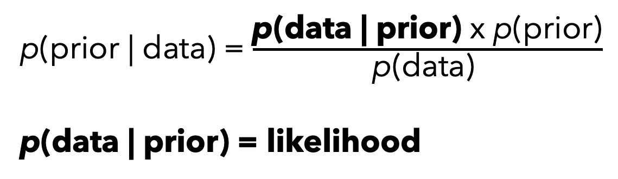
Bayes Factor
H₁ = Vocabulary knowledge goes up as age goes up
H₀ = Vocabulary knowledge remains the same over the lifespan (unlikely)
p(prior | data) = $\frac{\text{p}\text{(}\text{data}\text{ | }\text{prior}\text{) }\text{x} \text{p}\text{(}\text{prior}\text{)}}{\text{p}\text{(}\text{data}\text{) }}$
$\text{p}\text{(}\text{data}\text{ | }\text{prior}\text{)}$ = likelihood
$\frac{likelihood of the data given H1}{likelihood of data given H0}$ = $\frac{p(D| H1)}{p(D| H0)}$

Slide 68
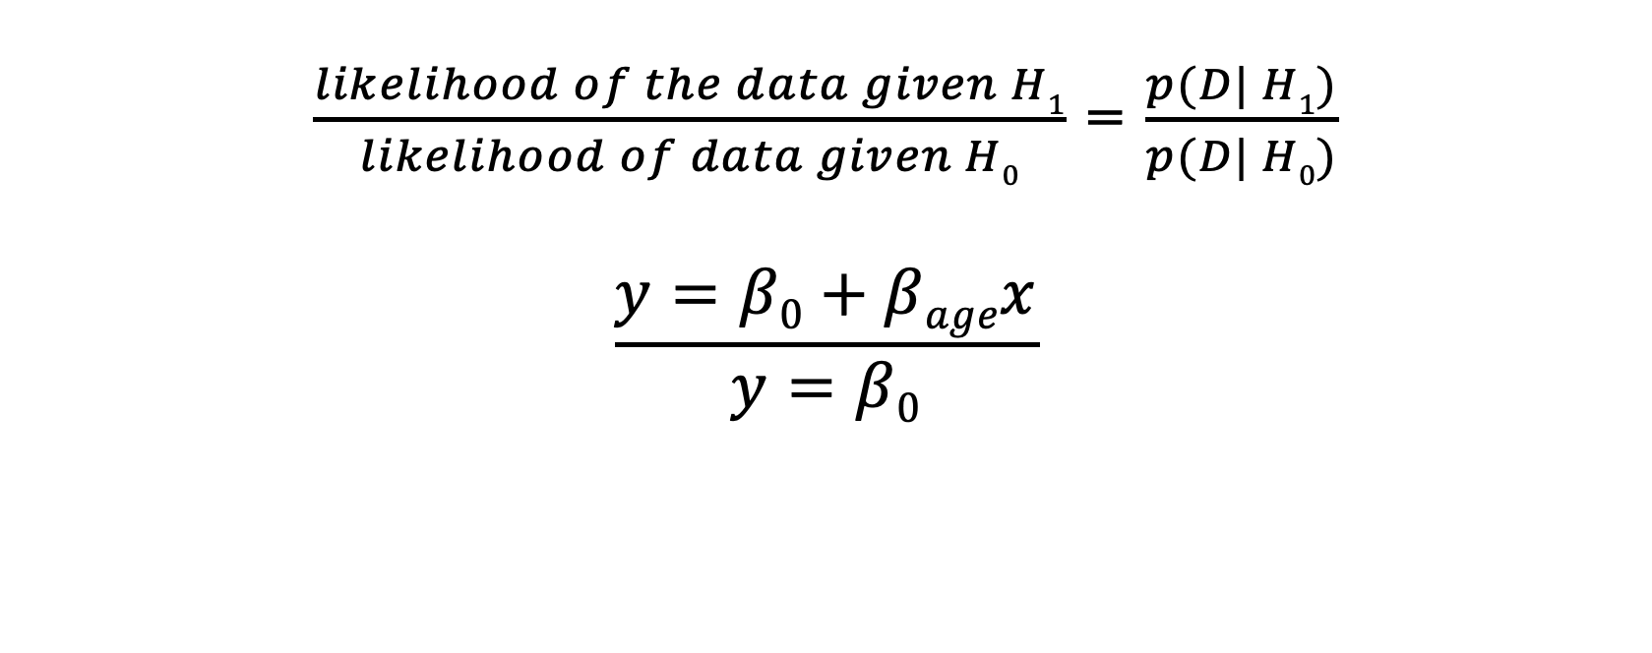
The Bayes Factor
$\frac{likelihood of the data given H1}{likelihood of data given H0}$ = $\frac{p(D| H1)}{p(D| H0)}$
$$\frac{y=β0+βagex}{y=β0}$$
Notes:
If the numerators is larger, there’s more evidence and if it’s smaller there’s less evidence.

Slide 69
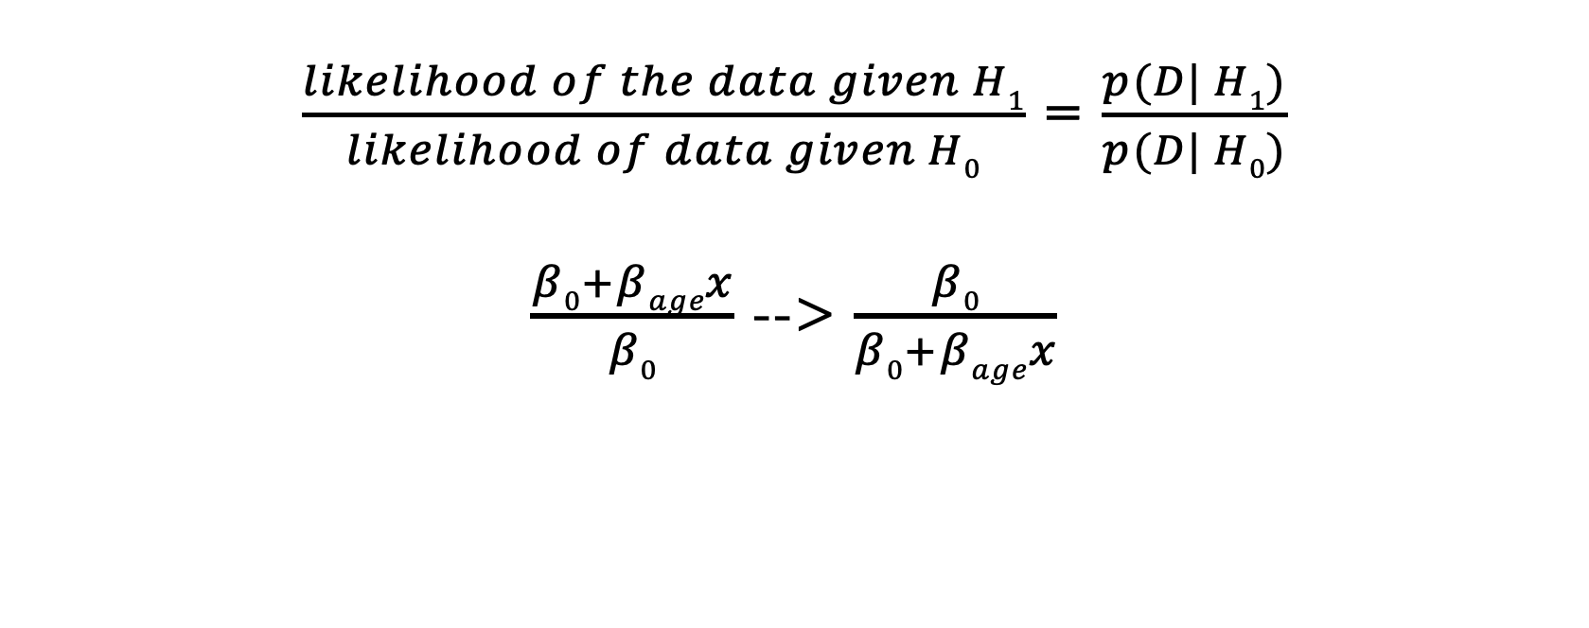
The Bayes Factor
$\frac{likelihood of the data given H1}{likelihood of data given H0}$ = $\frac{p(D| H1)}{p(D| H0)}$
$\frac{β0+βagex}{β0}$ --> $\frac{β0}{β0+βagex}$

Slide 70
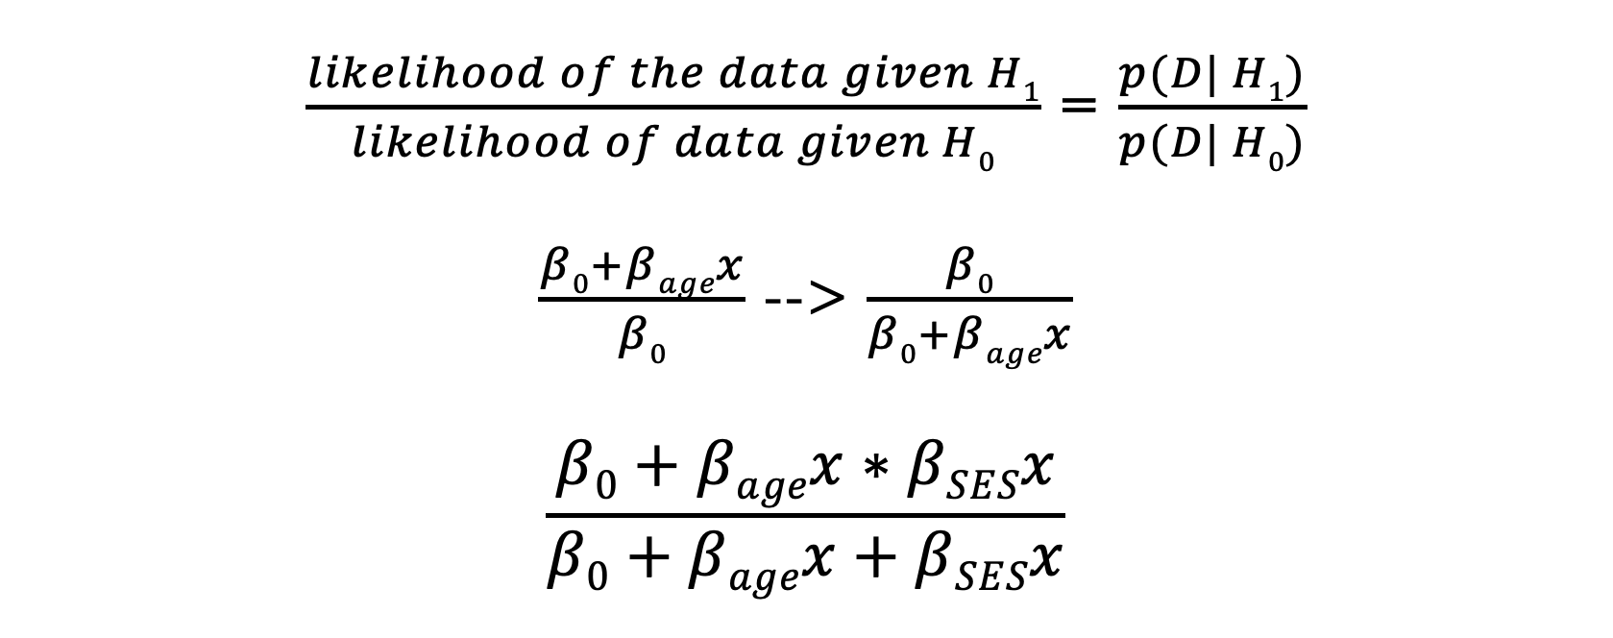
The Bayes Factor
$\frac{likelihood of the data given H1}{likelihood of data given H0}$ = $\frac{p(D| H1)}{p(D| H0)}$
$\frac{β0+βagex}{β0}$ --> $\frac{β0}{β0+βagex}$
$$\frac{β0+βagex∗βSESx}{β0+βagex+βSESx}$$
Notes:
The hypothesis includes the prior. Given a hypothesis of effect size x. Then if we have a small but “sig” effect size, the probability of that hypothesis (prior) is small.
Put the bayes equation up with prior informaiton

Slide 71
The Bayes Factor
Data Size | Significant? | Prior | Bayes Factor BF₀₁ Favors the Null | Bayes Factor BF₁₀ Favors the alternative
Small | No | Flat | 3.23 | 1/3.23 = .31
The likelihood of the Null is 3.23 times greater than the likelihood of the alternative.

Slide 72
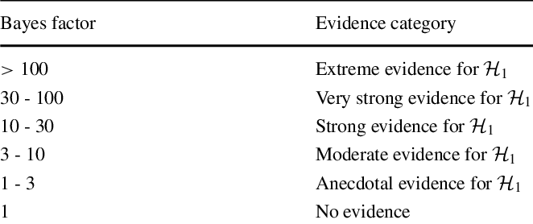
The Bayes Factor Jeffrey’s Levels
Data Size | Significant? | Prior | Bayes Factor BF₀₁ Favors the Null | Bayes Factor BF₁₀ Favors the alternative
Small | No | Flat | 3.23 | 1/3.23 = .31
The likelihood of the Null is 3.23 times greater than the likelihood of the alternative.
Notes:
Of course, this is starting to look like p-values because we have these arbitrary cut offs. So now you’re starting to see why there’s controversy, but it gets more complicated because

Slide 73
The Bayes Factor
Data Size | Significant? | Prior | Bayes Factor BF₀₁ Favors the Null | Bayes Factor BF₁₀ Favors the alternative
Small | No | Flat | 3.23 | 1/3.23 = .31
Small | No | Diffuse | 45.6 | .02
Small | No | Weak | 5.17 | .19
Small | No | Informative | 7.25 | .14
Small | No | Hyper-Informative | 9.54 | .10
Notes:
The bayes factor changes as we change our prior. In particular, a diffuse prior can be very problematic.

Slide 74
The Bayes Factor
When we include effect sizes in our priors that surround our data, our evidence for the null grows.
Notes:
The bayes factor changes as we change our prior. In particular, a diffuse prior can be very problematic.
The diffuse prior has the peak to show a greater density if the posterior is peaking within it.
Flat prior is more like the regular regression

Slide 75
https://vasishth.github.io/bayescogsci/book/sec-N400BF.html
Notes:
Hyper informative priors can also be problematic and favor the null.
The expected huge effect doesn’t exist so we get a bayes factor in favor of the null.

Slide 76
The Bayes Factor
Data Size | Significant? | Prior supports H_{A} | Bayes Factor BF₀₁ Favors the Null | Bayes Factor BF₁₀ Favors the alternative
Small | No | Flat | 3.23 | 1/3.23 = .31
Small | No | Diffuse | 45.6 | .02
Small | No | Weak | 5.17 | .19
Small | No | Informative | 7.25 | .14
Small | No | Hyper-Informative | 9.54 | .10
Small | Yes | Flat | .0006 | 1719.15
Small | Yes | Diffuse | .04 | 25
Small | Yes | Weak | .005 | 200
Small | Yes | Informative | 8.67 | .12
Small | Yes | Hyper-Informative | >1000 | <.0001

Slide 77
The Bayes Factor
Significant data (40 obs)
Notes:
It is important to recognize that this is an issue of having priors that are not included in the evidence though. It shows up most clearly when we have a diffuse prior but it can also happen if we have a really narrow prior that never occurs in our evidence.
then you’re narrowing what you consider to be correct results
This is happening because the informative priors are on the other side of the data. There's less effect than our prior beliefs would indicate.

Slide 78
The Bayes Factor
Data Size | Significant? | Prior supports H_{A} | Bayes Factor BF₀₁ Favors the Null | Bayes Factor BF₁₀ Favors the alternative
Large | Yes | Flat | .17 | 5.85
Large | Yes | Diffuse | <.0001 | >10,000
Large | Yes | Weak | <.0001 | >10,000
Large | Yes | Informative | <.0001 | >10,000
Large | Yes | Hyper-Informative | >10,000 | < .0001
Notes:
The problems do diminish if you have more evidence.

Slide 79
Setting Appropriate Priors
diffuse <- c(set_prior("normal(0,100)", class = "b", coef = "age"),
set_prior("student_t(3,200,2.5)", class="Intercept"))
weak <- set_prior("normal(0,10)", class = "b", coef = "age")
informative <- set_prior("normal(0,1)", class = "b", coef = "age")
hyperinformative <- set_prior("normal(0,0.1)", class = "b", coef = "age")
Prior belief = no effect
Notes:
Let’s return to setting our priors.

Slide 80
The Bayes Factor
Data Size | Significant? | Prior supports H_{A} | Bayes Factor BF₀₁ Favors the Null | Bayes Factor BF₁₀ Favors the alternative
Large | No | Flat | 8.33 | .12
Large | No | Diffuse | 150.58 | .007
Large | No | Weak | 16.75 | .06
Large | Yes | Flat | .17 | 5.85
Large | Yes | Diffuse | <.0001 | >10,000
Large | Yes | Weak | <.0001 | >10,000
Large | Yes | Informative | <.0001 | >10,000
Large | Yes | Hyper-Informative | <.0001 | >10,000

Slide 81
The Bayes Factor
Data Size | Significant? | Prior supports H_{A} | Bayes Factor BF₀₁ Favors the Null | Bayes Factor BF₁₀ Favors the alternative
Large | No | Flat | 8.33 | .12
Large | No | Diffuse | 150.58 | .007
Large | No | Weak | 16.75 | .06
Large | No | Informative | 1.77 | .56
Large | No | Hyper-Informative | 1.01 | .99
Large | Yes | Flat | .17 | 5.85
Large | Yes | Diffuse | <.0001 | >10,000
Large | Yes | Weak | <.0001 | >10,000
Large | Yes | Informative | <.0001 | >10,000
Large | Yes | Hyper-Informative | <.0001 | >10,000

Slide 82
The Bayes Factor
Data Size | Significant? | Prior supports H_{A} | Bayes Factor BF₀₁ Favors the Null | Bayes Factor BF₁₀ Favors the alternative
Large | No | Flat | 8.33 | .12
Large | No | Diffuse | 150.58 | .007
Large | No | Weak | 16.75 | .06
Large | No | Informative | 1.77 | .56
Large | No | Hyper-Informative | 1.01 | .99
Large | Yes | Flat | .17 | 5.85
Large | Yes | Diffuse | <.0001 | >10,000
Large | Yes | Weak | <.0001 | >10,000
Large | Yes | Informative | <.0001 | >10,000
Large | Yes | Hyper-Informative | <.0001 | >10,000
Notes:
If se wet reasonable priors, we get data that more accurately resembles this graph.
Do a sensitivity analysis
Run these with lots of priors, report the more conservative, but be careful of overdoing it. When you start to see the extreme informative prior is dropping your evidence more than just an informative prior, you’ve probably gone too far.

Slide 83
The Bayes Factor
Data Size | Significant? | Prior supports H_{A} | Bayes Factor BF₀₁ Favors the Null | Bayes Factor BF₁₀ Favors the alternative
Large | No | Flat | 8.33 | .12
Large | No | Diffuse | 150.58 | .007
Large | No | Weak | 16.75 | .06
Large | No | Informative | 1.77 | .56
Large | No | Hyper-Informative | 1.01 | .99
Large | Yes | Flat | .17 | 5.85
Large | Yes | Diffuse | <.0001 | >10,000
Large | Yes | Weak | <.0001 | >10,000
Large | Yes | Informative | <.0001 | >10,000
Large | Yes | Hyper-Informative | <.0001 | >10,000
Notes:
Why is this one so different?

Slide 84
Overview of Bayesian Stats
Principles of Probability
The Bayes Factor
Setting Appropriate Priors
BRMs & Stan – The R Code
Reporting Your Results
Why bother?
Notes:
The answer to that has to do with where this code comes from. So let’s dive into that.

Slide 85
The R Code
Packages:
brms
BayesFactor
rstanarm

Slide 86
The R Code
Flat <- brm(vk~age, data=df.ns.small, family=gaussian(), chains=4, iter=2000, cores=2, sample_prior = TRUE, save_pars = save_pars(all=TRUE))

Slide 87
The R Code
Flat <- brm(vk~age, data=df.ns.small, family=gaussian(), chains=4, iter=2000, cores=2, sample_prior = TRUE,save_pars = save_pars(all=TRUE))

Slide 88
The R Code
Flat <- brm(vk~age, data=df.ns.small, family=gaussian(), chains=4, iter=2000, cores=2, sample_prior = TRUE, save_pars = save_pars(all=TRUE))

Slide 89
The R Code
Flat <- brm(vk~age, data=df.ns.small, family=gaussian(), chains=4, iter=2000, cores=2, sample_prior = TRUE, save_pars = save_pars(all=TRUE))

Slide 90
The R Code
prior_summary(Inf)
informative <- c(set_prior("normal(0,100)", class = "b", coef = "age"),
set_prior("student_t(3,200,2.5)", class="Intercept"))

Slide 91
The R Code
Flat <- brm(vk~age, data=df.ns.small, family=gaussian(), chains=4, iter=2000, cores=2, sample_prior = TRUE, save_pars = save_pars(all=TRUE))
Inf <- brm(vk~age, data=df.ns.small, family=gaussian(), chains=4, cores=2, prior=informative, sample_prior = TRUE, save_pars=save_pars(all=TRUE))

Slide 92
The R Code
With BayesFactor Package
Bf <- lmBF(vk~age, df)
With brms
Set a null model null <- update(inf, formula = ~ . -age)
Compare the models
bayes_factor(null, inf)
Notes:
Run it a few times.

Slide 93
Overview of Bayesian Stats
Principles of Probability
The Bayes Factor
Setting Appropriate Priors
BRMs & Stan – The R Code
Reporting Your Results
Why bother?

Slide 94
Write-Up
Effect size from Bayes Analysis should be reported with credible intervals
Explain what bayes factors are
This includes establishing notation and levels for interpretation.
BF₀₁ or BF₁₀
Explain how BF were calculated (iterations, chains, priors, sensitivity)
Next to a p-value, write the notation for the BF₀₁ or BF₁₀ and give the value (BF₀₁ = 25)
Explain the strength of the evidence using Jeffrey’s levels (or other)

Slide 95
Write-Up
… p = .65, BF₀₁ = 25. Here, the Bayes Factor provides strong evidence for the null hypothesis that cleft and connective presence neither increase nor decrease reading times for the non-focused target word.
Notes:
Norberg & Fraundorf (2021) Memory benefits from contrastive focus truly require focus: Evidence from clefts and connectives (page 9)

Slide 96
Overview of Bayesian Stats
Principles of Probability
The Bayes Factor
Setting Appropriate Priors
BRMs & Stan – The R Code
Reporting Your Results
Why bother?

